Slide 1
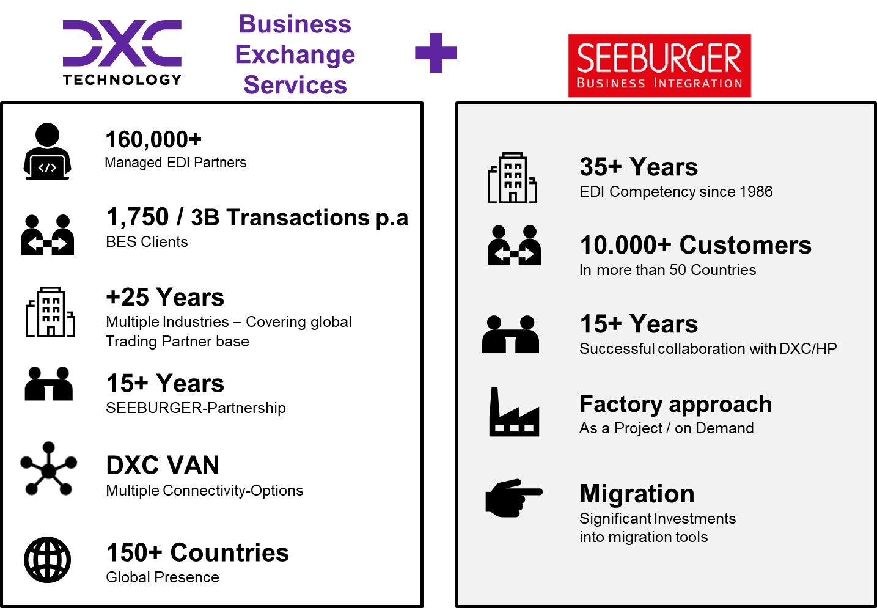
DXC BES SEEBURGER COE
Key services and solutions
EDI
20+ Years creating and running EDI Solutions
MFT
Flexible , customized MFT Solutions
FXS
Human-to-human secure file exchange
Migrate
Proven capabilities to replace your legacy EDI solution with state-of-the-art software
Run
We support your environment cost-efficiently and with highest quality
For dedicated and bespoke SEEBURGER integration solutions:
EDI, MFT, File Exchange – on-premise or in the cloud
Key Differentiators And Value Propositions
We have a global team with 20+ years of EDI/B2B and 15+ years experience on SEEBURGER products
As part of the DXC Business Exchange Services (BES) organization, we have access to 200+ further integration experts across the globe
We run DXC’s own EDI and MFT environments with the same products and expertise as we use with our clients
In close partnership with SEEBURGER, we modernize your Integration environment, using state-of-the-art technologies and tools
We have the experience and tools to guide you and your trading partners through this migration, utilizing self-service and other proven migration techniques
We implement proven best-practices and processes to improve compliance and long-term supportability
We adjust to your hosting and operations preferences. From on-premise to public cloud, from managed service to self-supported
Security, High Availability and DR are at the center of our solutions
We have the expertise and experience in managing operations to provide the highest quality of support for your environment

